Slide 1
Nearest Neighbor Matchmaking
Fariba Amiri, Sumaiya Azad, Shreeda Ghatpande, Jacob Hopkins & Andy Herbert

Slide 2
Problem Description
Modern multiplayer games must create matches that are:
Fair i.e players of similar skill and rank
Fast i.e minimal wait time
Stable i.e low latency, same region when possible
Core Problem: How can we form balanced, high-quality matches quickly at large scale?
Traditional matchmaking systems (like matchtrees or simple queues) fail to balance these goals effectively in a large scale distributed system.
Fariba Amiri, Sumaiya Azad, Shreeda Ghatpande, Jacob Hopkins & Andy Herbert

Slide 3
Project Idea
Distribute systems (players) across server workloads (game servers) using Approximate Nearest Neighbor (ANN) and matchmaking
ANN- using vectorized attributes, select shard(s) likely to contain value
Represented by global regions
Matchmaking- create “ideal” groups of players which will perform some work
MatchTree
Fariba Amiri, Sumaiya Azad, Shreeda Ghatpande, Jacob Hopkins & Andy Herbert
Notes:
Andy

Slide 4
Project Description
Question:
Can Approximate Nearest Neighbor (ANN) algorithms like FAISS improve matchmaking quality in multiplayer games by creating more balanced and faster matches compared to traditional matchmaking algorithms?
Solution:
ANN-based matchmaking will improve the quality of player matchups in terms of skill, rank, and latency.
ANN will create faster, more balanced matches compared to baseline.
Fariba Amiri, Sumaiya Azad, Shreeda Ghatpande, Jacob Hopkins & Andy Herbert
Notes:
Presented by Shreeda Ghatpande
ANN-based retrieval will outperform FIFO baselines by achieving lower match variance and faster match formation time, without compromising scalability. Fair i.e players of similar skill and rank
Fast i.e minimal wait time
Stable i.e low latency, same region when possible

Slide 5
Measured Metrics:
Rationale for Metrics:
Quality of Matches: Use z-scores to quantify similarity between player attributes.
Throughput: Track the number of matches generated over time.
Scalability: Measure system performance as the number of players increases.
Baseline:
Creating matches on first 10 players as a first-come-first-serve basis.
Fariba Amiri, Sumaiya Azad, Shreeda Ghatpande, Jacob Hopkins & Andy Herbert
Notes:
Presented by Shreeda Ghatpande

Slide 6
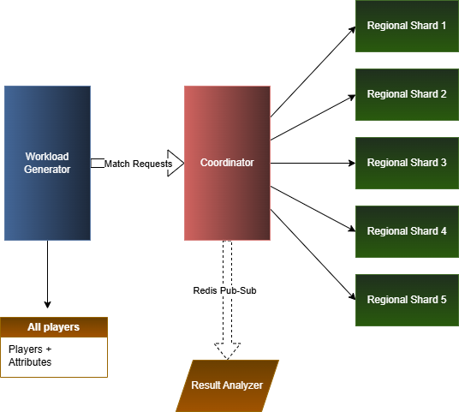
System Overview
Workload generator
Coordinator
Regional server(local shard)
Result Analyzer
Get Players for a match is the distributed operation.
Fariba Amiri, Sumaiya Azad, Shreeda Ghatpande, Jacob Hopkins & Andy Herbert
Notes:
Presented by Shreeda Ghatpande

Slide 7
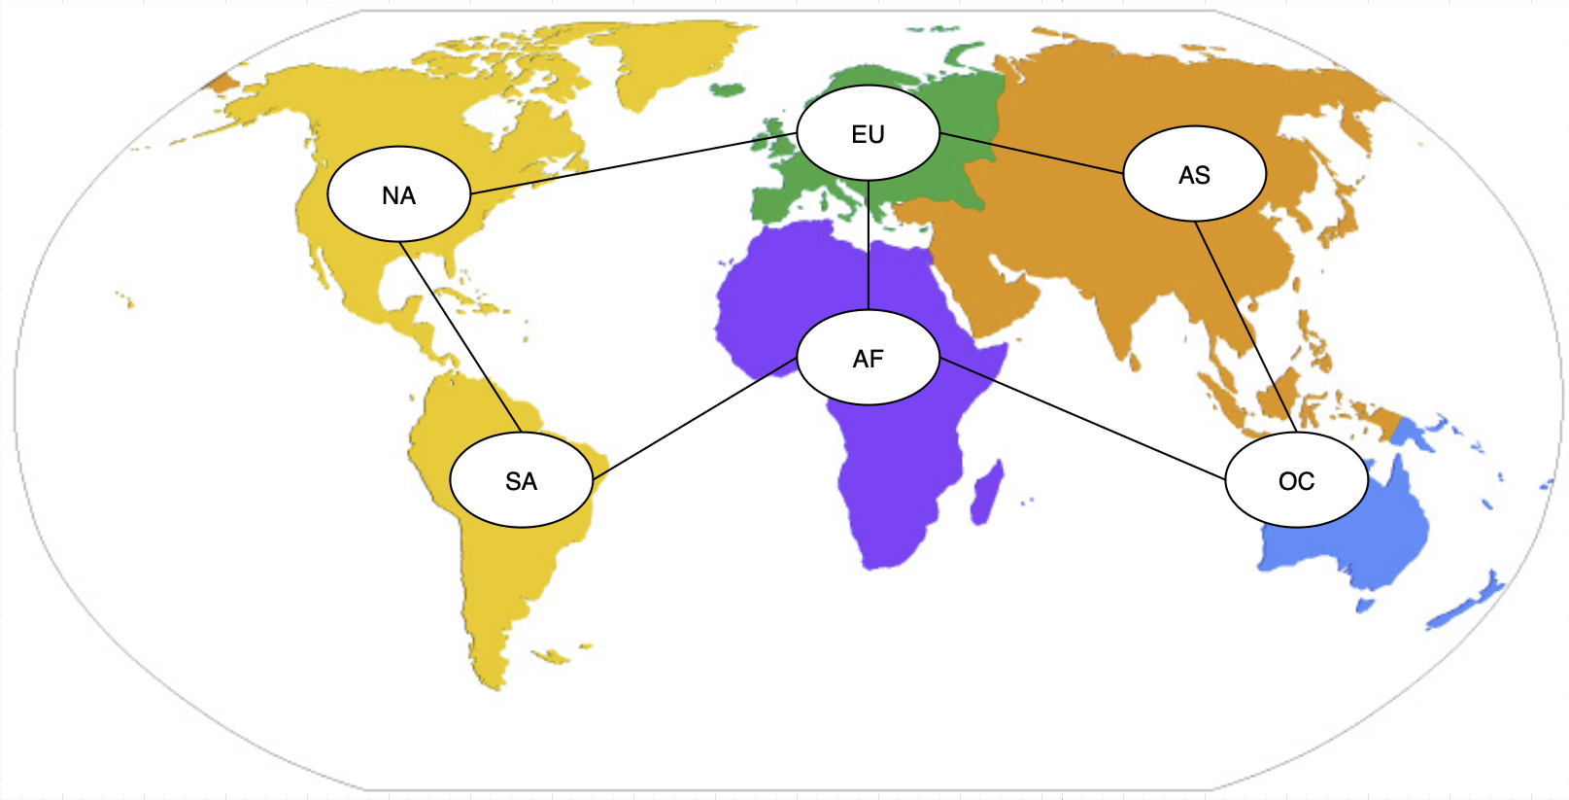
Coordinator
The ordering or queueing of players to be added to matches
Describe player attributes and encoding.
How coordinator creates queues
for different benchmarking?
[2]
Fariba Amiri, Sumaiya Azad, Shreeda Ghatpande, Jacob Hopkins & Andy Herbert
Notes:
Presented by Sumaiya Azad

Slide 8
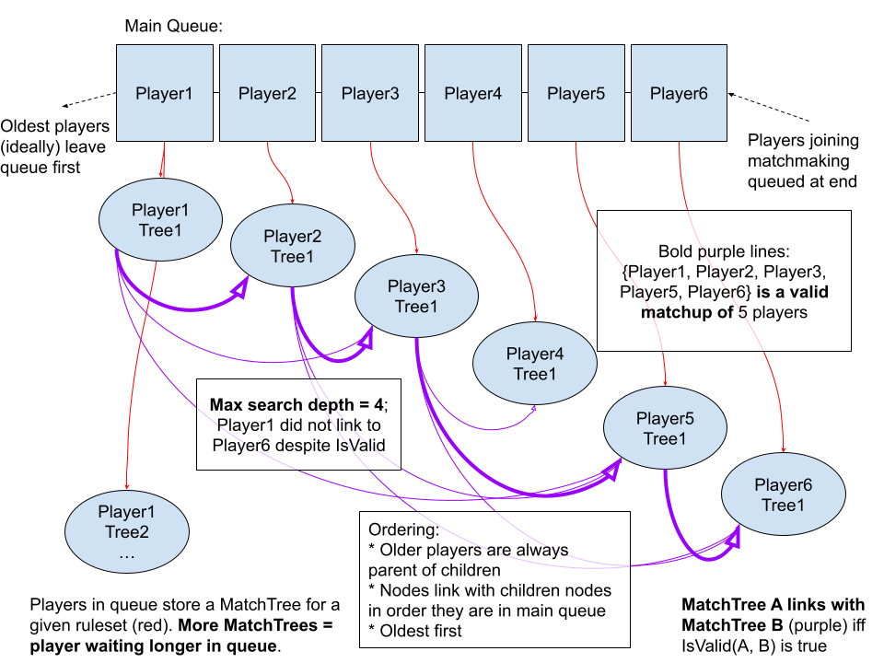
MatchTree- matchmaking algorithm
Emphasis: minimize wait time, maximize ideal matches
Ruleset: conditions which indicate if a group of players is valid
MatchTree: links to players creating valid matches with a ruleset
Handle thousands of players: pruning, optimizations
Priority further selects ideal matches
Fariba Amiri, Sumaiya Azad, Shreeda Ghatpande, Jacob Hopkins & Andy Herbert
Notes:
Andy
Most existing algorithms for matchmaking focus on pairing players into matches- emphasis more on maximizing similar skill or other attributes, not so much minimizing wait times
The challenge: fairness.
Players most similar to other players waiting would be quick to match up
Players who are outliers to other players waiting will wait a long time to match up
MatchTree: a compromise
Try to make a match with the best rules dictating a valid match. If that fails after a while, use the second best rules
All the way down to baseline- any matchup allowed
Priority selection: given all matchups available, select the best, and assign to each player in the match
Starting with oldest player, best ruleset
Discards matches where at least one player already placed into match
Pros
Fast runtime (k=num players, N=link depth, T=num trees, d=match search depth, L=max potential matchups to return)
N, d, L constants
O(k*N) tree creation
O(N) tree update
O(k*d*L) best case match search, O(k*d*N) worst case match search
Might be some log based runtime with search
Additional caching reduces repeat searches
Should make roughly good matches for all players
Multithread capable searching (+ potential distributed systems search)
Scalable to thousands of players
Supports different formulas for matchmaking (elo, trueskill, etc)
Cons
Player removal can create inconsistency with trees
Solution: occasionally reconstruct entire tree
pruning
Too high N, L can slow algo
Too low N reduces matchups returned
Priority search less optimized
Rulset implementation dependent on developer, could be made inefficient

Slide 9
Player Generation and Attributes
Goal
generate players with realistic gaming attributes
simulate real online games by differing attributes
Attributes
Skill Level - measure of how good the player is
mostly average players, few very high-skill players
Latency - player’s network delay to the server
mostly low latency, some high-latency players
Region - player’s geographical server representation
cross region matches increases delay
Rank - based directly on Skill Level thresholds
determined from skill (Bronze → Silver → Gold → Diamond → Grandmaster)
Playtime Hours - player’s online time
some players play a lot and some very little
Fariba Amiri, Sumaiya Azad, Shreeda Ghatpande, Jacob Hopkins & Andy Herbert
Notes:
Presented by Sumaiya Azad
For our project, we first needed a realistic player population. So we generated players with different gaming attributes to simulate something close to a real matchmaking environment. That means players should differ in skill, latency, region, rank, and playtime — just like in real online games.For skill level, we used a Chi distribution. That naturally gives us many average players and only a few really high-skill players, which feels realistic. Latency is also drawn from a Chi distribution, so most players have low ping but some have very high ping values. High latency means poor gameplay. Every player is assigned a region — NA, EU, AS, SA, AF, or OC — to represent geographical servers. Cross region matches increase delay or latency. Rank is determined directly from the skill level, following a Bronze → Grandmaster scale. Finally, playtime hours follow a normal distribution. This simulates that some players play a lot and some very little. These attributes help us build a diverse and realistic dataset for matchmaking benchmarking.

Slide 10
Player Encoding for FAISS
For Unweighted Encoding (Baseline FAISS), each player is converted to a numeric vector of
Skill
Latency
Rank Index
Playtime hour
One hot region vector
➡️ All attributes treated equally in distance calculation
For Weighted Encoding (Improved FAISS), we applied custom weights
Skill * 5
Latency * 2
Rank Index * 10
Playtime hour * 0.5
One hot region vector * 0.2
➡️ Makes matchmaking prefer skill-rank similarity more strongly
Fariba Amiri, Sumaiya Azad, Shreeda Ghatpande, Jacob Hopkins & Andy Herbert
Notes:
Presented by Sumaiya Azad
To use FAISS, each player must be converted to a numeric vector. For the unweighted encoding, we treat all attributes equally. But to improve matchmaking quality, we created a weighted encoding. In the weighted version, more important attributes — like rank and skill — get higher weights. Less important ones — like region — get smaller weights. This lets FAISS prioritise similarity in rank and skill more strongly, which leads to better groupings.

Slide 11
Workload Generation
Goal - simulate a realistic stream of players requesting matches and entering the queue
How it works
Each request picks a player ID from CSV
Probability of choosing a player is proportional to: (playtime_hours + 1)^hot_player_bias
Active player appearing more often in matchmaking simulates real online player behaviour
hot_player_bias = 1.5 → heavy, active players appear more often
Outcome - A workload list of player IDs which simulates a busy server with repeated match requests
Fariba Amiri, Sumaiya Azad, Shreeda Ghatpande, Jacob Hopkins & Andy Herbert
Notes:
Presented by Sumaiya Azad
Next, we needed a way to simulate a busy server where players continuously request matches. Workload generation concept is basically who is entering the queue. Our workload generator picks players in a probabilistic way. Players with more playtime have a higher chance of appearing — because active players queue more often in real life. We control this with a parameter called hot_player_bias. We use 1.5, which means heavy players appear significantly more often. This creates a workload of 100,000 player IDs that we feed into the matchmaking algorithms. Overall, this workload behaves like a real server where some players constantly re-queue while others appear rarely based on their playtime hour

Slide 12
Matchmaking
FIFO Queue Matchmaking
Maintain a queue of players arriving from workload
When there are enough distinct players in the queue,
form a match, mark them as busy
remove from the queue and continue
FAISS-Based Matchmaking
Neighbors selected using simple euclidean distance
For each workload seed:
picks its nearest non-busy neighbors
Weighted FAISS Matchmaking
Much better grouping of:
similar skill, rank & latency
➡️ Simple, fast
➡️ only arrival order matters
➡️ extremely low-quality matches
➡️ Distance purely based on raw attributes
➡️ Produces moderate-quality matches
➡️ Simulates an intelligent, optimized coordinator
➡️ Produces higher-quality, fairer matches
Fariba Amiri, Sumaiya Azad, Shreeda Ghatpande, Jacob Hopkins & Andy Herbert
Notes:
Presented by Sumaiya Azad
Players arrive in order and we simply pick the first 10 available players to form a match.It’s fast, but the match quality is very low because it ignores skill, rank, and latency completely.Arrival order is the only thing that matters.
Next, we use FAISS on the raw, unweighted vectors. It searches for the closest neighbors for each request. This produces better matches than FIFO because FAISS uses player attributes, but all attributes are treated equally.
Finally, we use Weighted FAISS, which is our improved version.By applying weights, we make FAISS prioritize similar skill, similar rank, and similar latency. This simulates a smarter matchmaking coordinator. Weighted FAISS produces the best overall match quality among the three.

Slide 13
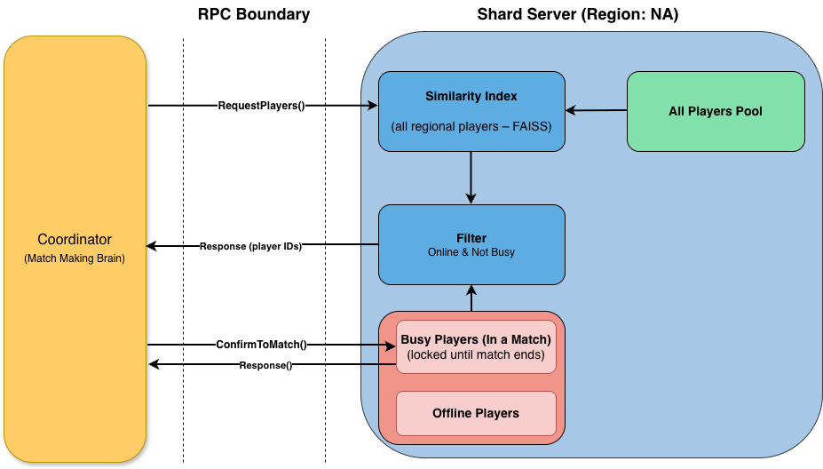
Server Shard: What It Is
Server Shard (Regional Matchmaking Engine)
Loads all players for one region (e.g., NA)
Converts players into vectors
Builds a FAISS index
Manages a subset of players marked online
Keeps track of players locked in a match (busy)
Answers similarity queries from the coordinator
Exposes gRPC APIs: RequestPlayers and ConfirmToMatch
Fariba Amiri, Sumaiya Azad, Shreeda Ghatpande, Jacob Hopkins & Andy Herbert
Notes:
Presented by Fariba Amiri Each shard represents one geographic region, like NA or EU. Each shard loads all players for that region from the CSV and uses them to build a FAISS similarity index. So FAISS always contains the entire regional player set — it does not change dynamically.
To manage player availability, the shard keeps two local pools: one pool tracks players who are offline, and another pool tracks players who are busy and already in a match. These pools are used later by the filter to remove players who should not be matched.
This setup lets the shard run fast similarity searches using FAISS while still respecting who is actually available. So overall, the shard works as a regional matchmaking engine that performs similarity search and maintains accurate player state.

Slide 14
Server Shard: What It Does
Runtime Behavior
Receives a query vector → performs FAISS nearest-neighbor search
Filters results based on:
Online status
Not busy (not already matched)
Returns best available players for that region
Supports locking:
ConfirmToMatch() marks selected players as busy
Runs a background process that reshuffles online players to simulate logins/logouts
Fariba Amiri, Sumaiya Azad, Shreeda Ghatpande, Jacob Hopkins & Andy Herbert
Notes:
Presented by Fariba Amiri
At runtime, the shard handles two gRPC calls. The first is RequestPlayers. It receives a query vector and runs a FAISS nearest-neighbor search over all regional players. After FAISS returns the similar candidates, the shard filters out any players who are either offline or already busy. This ensures the coordinator only receives players who are actually available for matchmaking.
The second RPC is ConfirmToMatch. When the coordinator forms a match, it sends the selected players back to the shard, and the shard marks those players as busy so they won’t appear in another match.
The shard also runs a background loop that reshuffles which players are online, simulating logins and logouts and keeping the availability pool dynamic.
So overall, the coordinator builds matches, and the shard ensures the player pool stays accurate, filtered, and up to date.

Slide 15
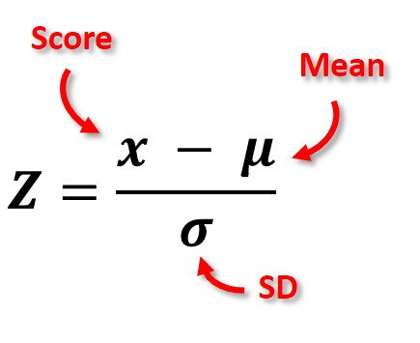
Results / Analysis
How do we Measure Quality?
What attributes are important?
FIFO baseline
[1]
Fariba Amiri, Sumaiya Azad, Shreeda Ghatpande, Jacob Hopkins & Andy Herbert
Notes:
Jacob Hopkins
An important challenge we faced was how do we quantify results? And what do we consider a good match? We used something called a z-score which is essentially a score of how many standard deviations a value is from the mean. So for each match and each individual attribute we calculate how many standard deviations the value is from the mean of the match.
We then apply weights to each z-score to give more weight to attributes we care more about.
From there we can create a super score using the average of each attributes Z-score.
Finally I need to mention throughput.

Slide 16
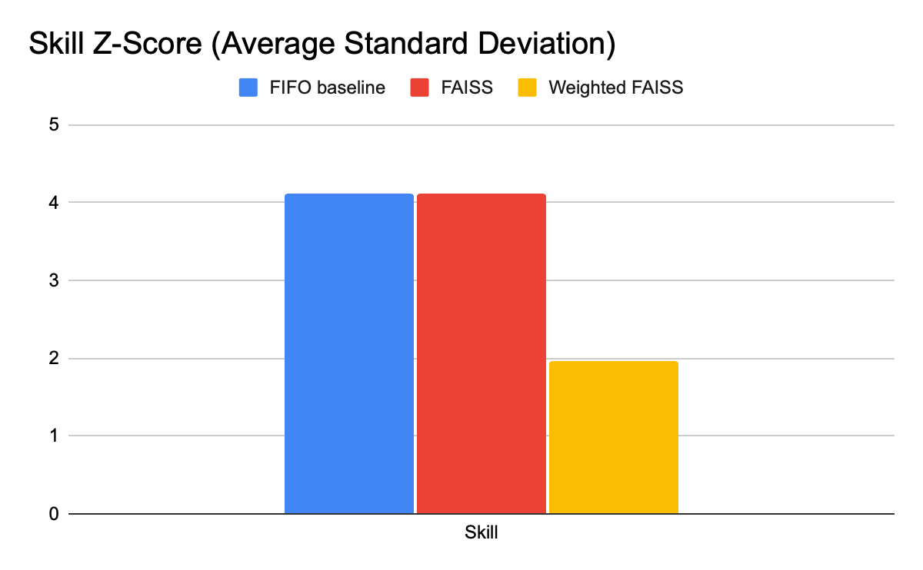
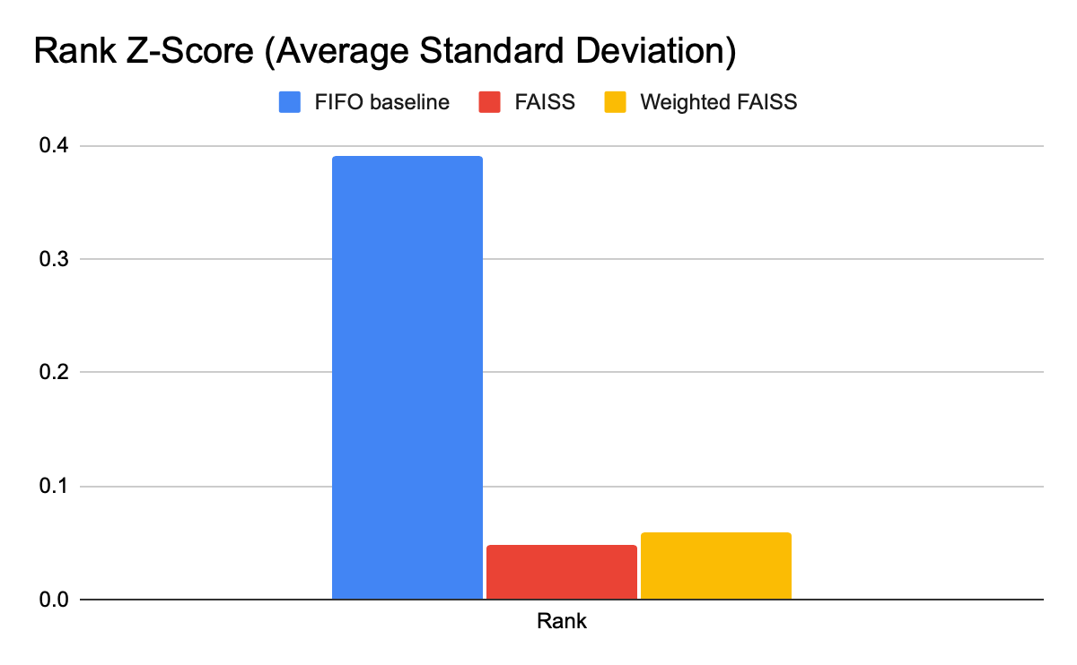
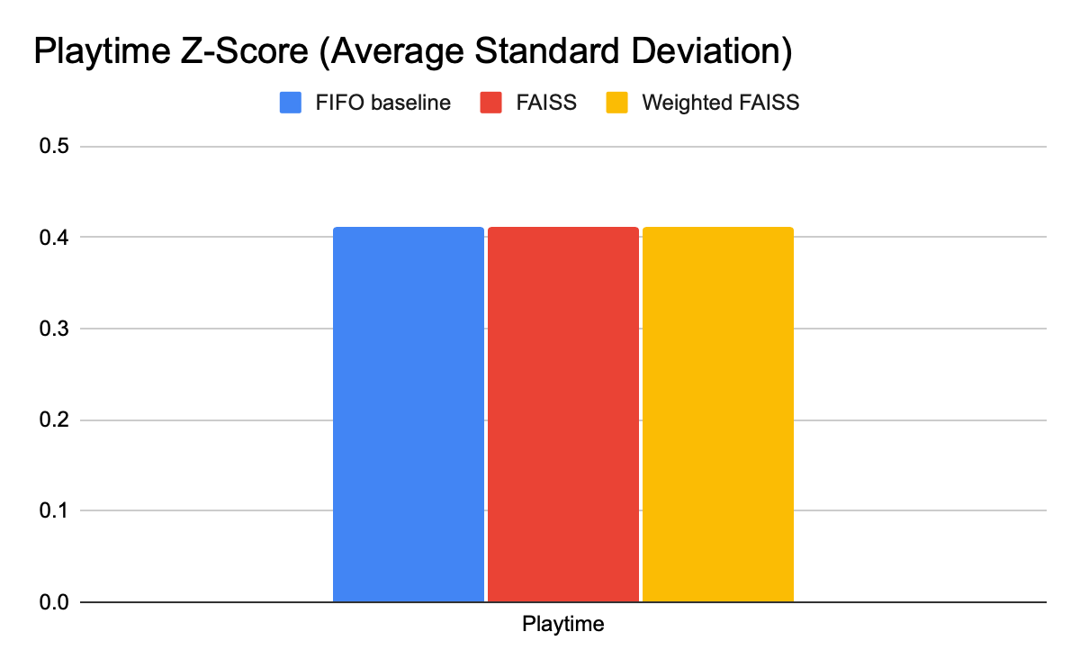
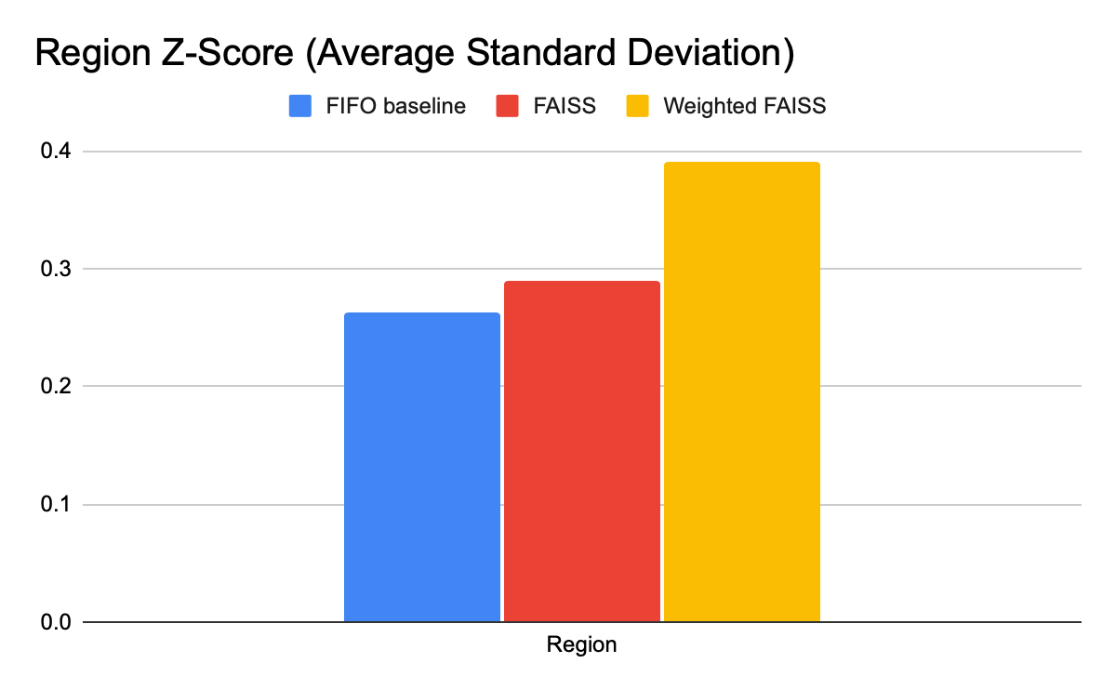
Lower = Better
Notes:
Jacob Hopkins
In order to measure the improvement of FAISS we needed to measure against a baseline. We created A FIFO baseline without any matchmaking algorithm to have something to compare our FAISS implementation to. We then measured that FIFO baseline against both a FAISS and Weighted FAISS algorithm. Important attributes like Rank and skill reached a much lower z-score which is good. Some attributes like Region saw little to no change.

Slide 17
Takeaways / lessons learned
Dataset generation and the impacts on the result
Define the scope and components very early.
Do not reinvent the wheel. We ended up drawing solutions from PA1 and PA2.
Have small test code every component easier to debug.
Fariba Amiri, Sumaiya Azad, Shreeda Ghatpande, Jacob Hopkins & Andy Herbert
Notes:
Jacob Hopkins will present this one
I'm going to lead us into takeaways that we learned from this project.
There are two main points we want to cover.
First is some of the technical takeaways: ADD MORE HERE
Second I want to cover more meta takeaways we got from designing a project like this.
A big takeaway we learned in this project is defining a clear research question or problem statement.
There are often a large amount of things that need to be abstracted away when designing a system like this so it's important to consider what aspects you are trying to measure and which need to be abstracted.
At first we attempted to have clients along with our coordinator and server. That became too difficult to manage having the coordinator both act as a server and client and then it was also unreasonable to simulate 100,000 client rpc calls we scaled the clients back.
In our case we abstracted away the physical game clients since we weren't as concerned with the clients workload and the process of connecting and reconnecting clients to game servers.
Another important consideration is a choice of data set. Synthetic datasets are good for testing but have a downside that you lose sense of what your measuring if the data isn't necessarily real.

Slide 18
Team Contributions
Shreeda - Coordinator and FAISS
Fariba - Regional servers
Sumaiya - Benchmarking matchmaking and dataset generation
Jacob - Server and Benchmarking
Andy - Matchmaking algorithm
Fariba Amiri, Sumaiya Azad, Shreeda Ghatpande, Jacob Hopkins & Andy Herbert

Slide 19
Q & A

Slide 20
Credits
[1]
“What Is A Z-Score And How To Calculate Them?” Accessed: Nov. 29, 2025. [Online]. Available: https://toptipbio.com/z-score/
[2]
“World Map / World Atlas / Atlas of the World Including Geography Facts and Flags - WorldAtlas.com,” WorldAtlas. Accessed: Nov. 29, 2025. [Online]. Available: https://www.worldatlas.com/

